Slide 1
Azure Time Series Insights
Speaker Name Speaker Title

Slide 2
Agenda
Azure Time Series Insights overview
Key capabilities and features
Architecture
Customer scenarios
Roadmap
Resources and next steps

Slide 3
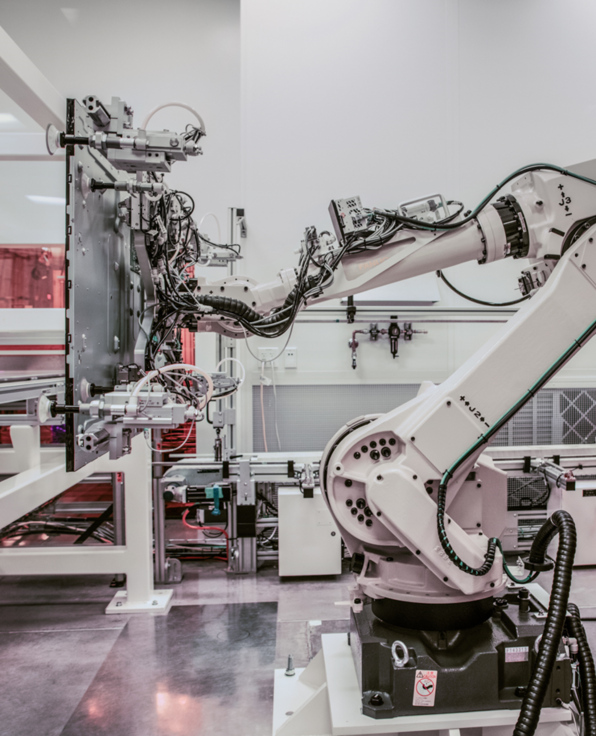
Azure Time Series Insights
End-to-end analytics platform to monitor, analyze, and visualize your industrial IoT data at scale

Slide 4


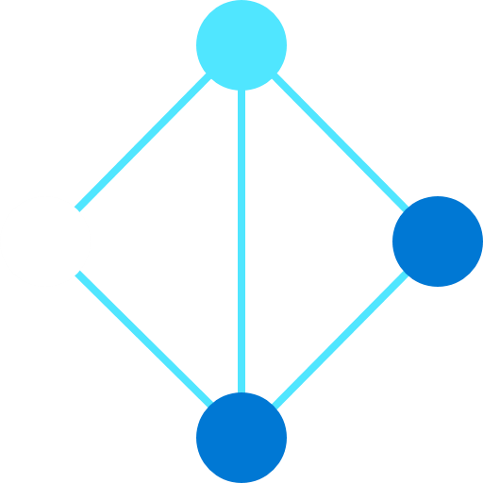

Industrial IoT Data Characteristics
IoT data is used with related data sets from 1st- or 3rd-party sources
IoT data lacks structural consistency
IoT data needs contextualization
IoT data requires near-infinite retention

Slide 5
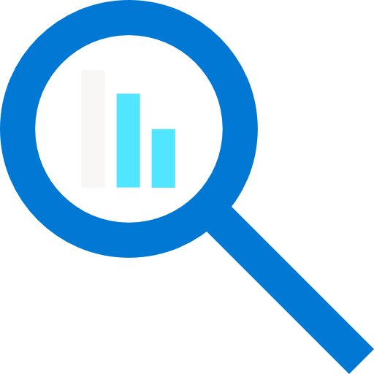



Azure Time Series Insights (TSI)
A fully managed platform as a service (PaaS) solution built for IoT
Ingest, process, store, query, and visualize highly contextualized, time-series-optimized, IoT data at scale
Connect to a variety of data solutions using TSI’s flexible data platform
Use rich analytics APIs and UX for ad-hoc exploration and operational intelligence
Use JavaScript SDK for building custom analytics apps on the TSI platform
Automated scaling and pay-as-you-go pricing
Turn data into decisions with actionable real-time IoT insights

Slide 6
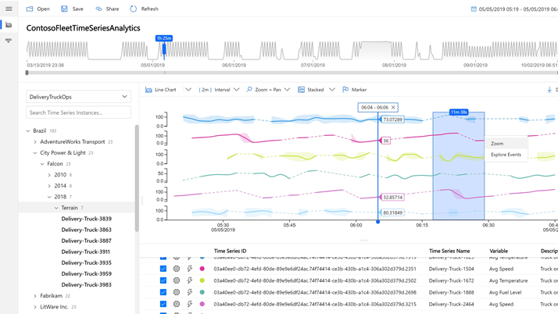
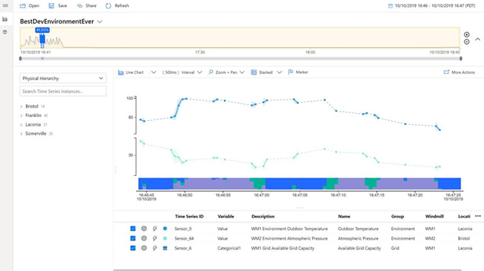
Azure Time Series Insights
Key capabilities
Multi-layered storage with warm and cold analytics support allowing customers to store data on warm store for interactive analytics over short timespans and to cold store for operational intelligence over decades of historical data
Data contextualization allows customers to describe the domain and metadata associated with the derived and raw signals from assets and devices.
Flexible data platform that allows customers to take data stored in open-source Apache Parquet to other advanced data analytics solutions such as Spark, Databricks, machine learning, and AI
Rich query APIs and user experience to support signal reconstruction for missing data, reduction operations, discrete signal processing, scatter plots, and time shifting of time series signals for in-depth analysis.
Enterprise-grade scale and performance at all layers of the solution to support customers’ industrial IoT solution needs
Rich extensibility through powerful connectors enables customers to take their time series data and consume them with other business systems.
Notes:
Data first contextualization – model later if you’ve got new data showing up in your streams

Slide 7



Azure Time Series Insights pay-as-you-go high-level architecture
Ingest
Store
Model
Analyze
</>
COLD STORE ADLS Gen 2/ Azure Blob
Azure Event
Hub
Time Series Model
Time Series Query API
Time Series Insights Explorer
Power BI Connector
3rd PARTY APPS
Azure IOT
Hub
Azure Digital Twins
Ingestion processing
WARM STORE ADX
</>
TSM Update API
Timeseries data
API requests/returns
AI/ML workflow
Notes:
Once Time Series Insights is up and running, new data is synced continuously via the TSM Update API, providing you near real-time visualizations of your streaming data. You can also send logical twin models and device twin models directly to the TSM Update API for seamless integration into the Time Series Model.
Transition: Does Time Series Insights support AI and machine learning? (click)

Slide 8


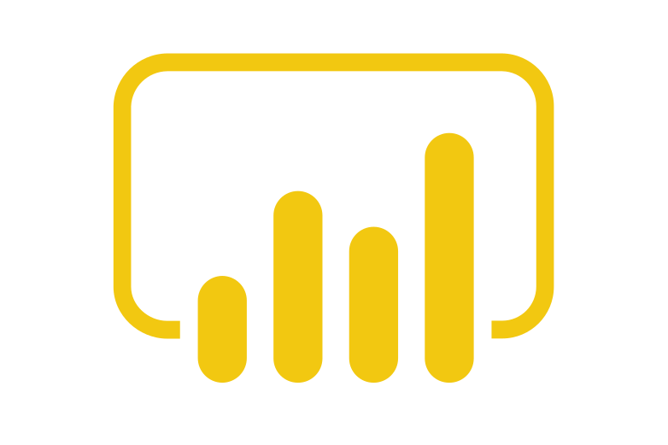











Case study: Manufacturing
Scenario: Operational intelligence and process improvement
Stream Processing
Actions and Alerts
Operational analysis
Stream Analytics
Azure Functions
Power BI
Azure Event Hubs
Time Series Model
Hierarchy
Types
Time Series Instances
Derived Time Series
Time Series Explorer
Query API
PLC / DCS / SCADA
IO / Gateway / Server
Azure IoT Edge with Protocol module
Azure IoT Hub
Time Series Insights
Custom Applications
Intelligent Insights
IIot Assets
Advanced Analytics
Azure Batch
Databricks
Machine Learning
Predictive Dashboards
Intelligent edge
Intelligent cloud

Slide 9




Case study: Smart buildings
Incident management & analysis
Stream Processing
Actions
Scenario: Anomaly detection and fault detection
Dynamics 365
Stream Analytics
Azure Functions
Power BI
Time Series Model
Hierarchy
Types
Time Series Instances
Event Enrichment
Time Series Explorer
Query API
Building
Building Management System
BACNet / I/O Gateway
Azure IoT Edge
Azure IoT Hub
Azure Functions
Azure Event Hubs
Time Series Insights
Custom Applications
Intelligent insights
Advanced Analytics
Identity Store
Azure Batch
Databricks
Machine Learning
Predictive Dashboards
Intelligent edge
Intelligent cloud

Slide 10

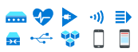

Anomaly detection and diagnosis
Uncovering the why:
Examples:
Understanding why equipment requires extra maintenance.
Searching why inventory was damaged.
Researching why production declined on an assembly line.
Chasing down a defect in the supply chain process.
3rd Party IoT apps using Time Series Insights APIs
Query API
IoT device, gateway, and application data
Azure IoT Hub
Time Series Insights
Time Series Insights JavaScript SDK
Time Series Insights Explorer
Notes:
We showed you one common use case for Time Series Insights- It’s all about uncovering Why something happened. What was different this time that produced another result.
TSI is primed for these use cases because:
No upfront data preparation needed
Connect to billions of events in Azure IoT Hub or Azure Event Hub, and visualize & analyze billions of events to spot anomalies and discover hidden trends in your data
Simple and easy to use exploration experience, while at the same time providing granular text-based querying for advanced users who are familiar with SQL
Perform DevOps analysis to get to the root cause of a bug in an IoT solution or identify areas to investigate for data science initiatives

Slide 11


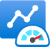
Operational intelligence and advanced analytics
Improving operations:
Stream processing
Operational efficiency
Azure Stream Analytics
Azure Logic App
Azure Functions
Real time dashboards
Time Series Insights Explorer
Examples:
Monitor equipment performance at scale
Identify process inefficiencies
Diagnose the health of equipment
Optimize supply chain and production
Real-time
Real time applications
Business systems (structured)
Event Hubs
Query API
IoT device, gateway, and application data on the edge
Self serve models
Azure IoT Hub
Time Series Insights
Predictive AI dashboards
Advanced Analytics
Azure Batch
Databricks
Machine Learning
Statistical analysis
Notes:
Another common use case for Time Series Insights is to improve your current operations. In near real-time you can monitor the end-to-end process and visually detect if something veers off course.
TSI is primed for these use cases because:
Semantically model asset data using time series model
Upload the model with variables, types, hierarchies, instances along with device telemetry data
Use highly scalable, performant, cost-effective queries to trend decades of device data to drive operational intelligence
Enable monitoring of the health, usage, and performance of your equipment, at scale, by connecting Time Series Insights to other data services for a variety of business and analytics scenarios
INSERT CUSTOMER STORY

Slide 12

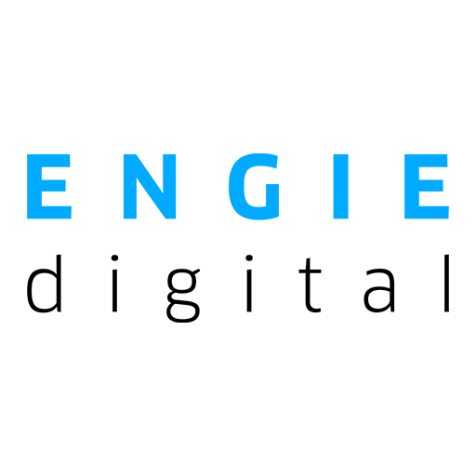
Customer: ENGIE
Industry: Energy
Size: 50-999 employees
Country: France
Products and services: Microsoft Azure Azure IoT Edge Azure IoT Hub Azure Time Series Insights Microsoft Power BI Read full story here >>
“We looked at a range of providers before we moved to the cloud. But we chose Azure because of its Time Series Insights capability—it really swung the decision for us.”
Sebastien Gauthier, Head of Darwin Delivery, ENGIE Digital
Situation To help fulfill its aim of making energy production cleaner and more cost‑effective, ENGIE needed an Internet of Things (IoT) data processing solution to augment its Darwin operational performance software and replace an aging, overstretched supervisory control and data acquisition system.
Solution By modernizing Darwin with Microsoft Azure Time Series Insights and Azure IoT Edge, ENGIE can now gather and process huge amounts of IoT asset data, using the analysis to improve energy production efficiency and cost-effectiveness.
Impact
Not only has the company gained access to powerful new data-driven insights, it can optimize plant performance and reduce downtime. By maximizing production output, ENGIE is one step closer to eliminating the world’s reliance on carbon-intensive energy.

Slide 13


Customer: Fonterra
Industry: Manufacturing
Size: 20,000 employees
Country: New Zealand
Products and services: Microsoft Azure Azure IoT Edge Azure IoT Hub Azure Time Series Insights
“With our data platform in Azure, we’ll be able to build more data-backed confidence that we’re manufacturing outstanding products that customers can trust.”
Nigel Russell, Product Owner for the Process Historian, Fonterra
Situation Fonterra produces 30 percent of the world’s internationally traded dairy products. It wanted to scale up use of operational data to proactively monitor manufacturing processes, but its existing historian solution was unable to meet ambitions of increased scalability and connectivity to new data sources.
Solution To centralize and scale its data collection and analytics, Fonterra began using Microsoft Azure IoT Hub, Azure Time Series Insights, and Azure IoT Edge. The co-operative created a cloud data historian, and it now gathers more than 1 million data points in real time.
Impact
With easy access to data collected from across all its manufacturing locations, Fonterra staff will increasingly use this data to gain insights and make data-driven decisions. This will generate value for the company through improved operational sustainability, efficiency, and innovation.

Slide 14













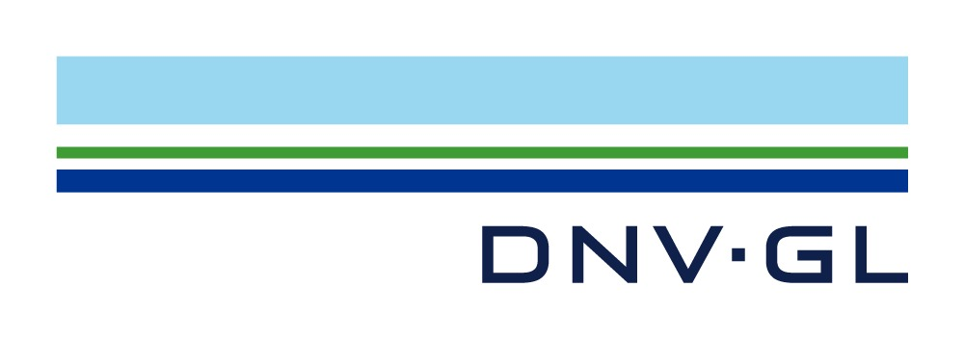


Azure Time Series Insights customer momentum
Manufacturing
Oil and Gas
Construction
Dairy Manufacturing
Mining
Automotive
Oil and Gas
Energy
Oil and Gas
Pump Manufacturing
Oil and Gas
Consumer Goods
Industrial IoT ISV
Process Manufacturing
Industrial IoT Consulting
Manufacturing

Slide 15
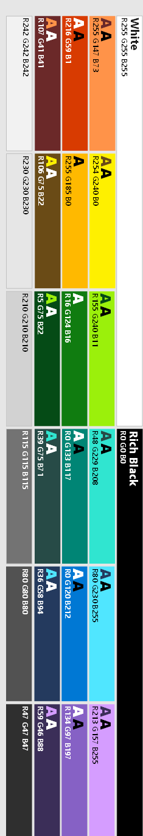





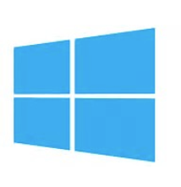


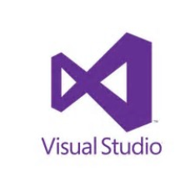
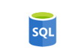

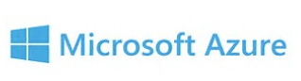


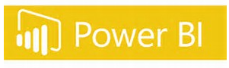
TSI Product Evolution Roadmap:
TSI and ADX Better Together
Turnkey telemetry and IoT ingestion
ADX Engine - forged in Microsoft production environments for planet-scale
Planet-scale insights engine balancing scale and power with simplicity
Asset Model contextualizing telemetry
KQL – best in class Timeseries analytics integrated with Python and R
Asset Model combined with KQL timeseries analytics
Data Insights based on low-code / no-code UX
Reduced Time to Insight (TTI) - Industry standard (IDW & CDM) semantic models unlock a new generation of turnkey industry focused insights
PAAS Managed Analytics Platform
Notes:
Top level framing for TSI + ADX working together to leverage each team’s strengths
All in one solution – you own your data – no lock in with the data present in OSS parquet

Slide 16
Time Series Insights (TSI) Product Evolution Roadmap [Tentative]:
TSI Innovation Waves
Today
Planet-Scale
Query & Modeling
Integrated TS Compute
Industry Focus
C# SDK, Fundamentals: E&R w/ CMK Private links (coming soon)
Turnkey simplicity deployments and UX over warm and cold storage
Time Series Model and Time Series Query API for asset-based analytics
Revamped, rich user experience (Scatted Plots, Categorical Variables, Swim Lanes, Auto-Refresh)
Enterprise Readiness—regional expansion, security, AAD etc.
ADX replat with open-store exhaust to open Parquet on customer provided ADLS G2 Store
Increased query concurrency & performance for ad-hoc queries over structured and unstructured data
Digital Asset Framework empowering data first ingress → model later with historized telemetry
KQL Timeseries Query Language integration
Dimension-based queries, LKV , “Fleet Query”
Industrial & scientific API’s FFT’s, Anomaly Detection & Forecasting
Integration with Common Data Model (CDM) and Azure Digital Twin (ADT) modeling
Calculation / Advanced Processing Engine
Derived Timeseries / down-sampling
Low-code, UX & SDK w/ integrated interactive query & scheduling to TSI Calc engine
Single and multi-timeseries auto-clustering differential analysis
UX & SDK convenience layers simplify common scenarios reduce time to insight (TTI)
TSI Partnerships drive industry specific semantic and ontology models
Industry based semantic / ontology models light up a new paradigm of ML based classifiers and insights
1st class integration across Microsoft Cloud assets i.e. Synapse & Purview
Edge and Azure ARC integration
Notes:
CDM Data models turn machine data into human interpretable data
No breaking changes in API’s. If you want new features, use new KQL end point.
Edge integration via collaboration with ADX and ARC teams

Slide 17
Q&A

Slide 18
Resources
Try Azure Time Series Insights!
Product website >>
Documentation >>
Tutorial >>
Product video >>
Public Preview Blog >>
Pricing >>
Demo environment >>
Time Series Insights Explorer >>

Slide 19
TSI & ADX - Analytics Workshop – Engagement Template – Customer Facing Content
TSI team is charted with delivering simple and powerful analytic experiences simplifying time to insight for partners consuming IoT and telemetry timeseries data. We deliver immediate value out of the box and along extensible libraries and data workflows integrated with ML solutions across the Microsoft Cloud. TSI empowers customers on their digital transformation to evolve, optimize and drive efficiency improvements based on planet-scale, interactive data analytics.
Survey Scope | Deep-dive Topics
Product wide (TSI & ADX) | Current use cases analyzing data in TSI vs. ADX Deep dives on process optimization, issue root-cause analysis Analytical use cases / gaps where you must fill in through custom solutions What are key challenges you have in your IoT projects ? Top analytical asks preventing adoption ? How would you prioritize the user personas within your organization who use TSI i.e., Data Scientists, Developers, Data Analysts and Engineers, Solution providers, Asset maintenance and operators etc. What are we getting wrong and need to course correct ? What should we keep doing ?
TSI / ADX UX | Top use cases currently and areas that you’d like to see improvement ?
Data Modeling Semantic description and ML | What scenarios do you use TSI in the absence of any Asset Model & Semantic Modeling ? (TSM) What Asset, Semantic, Digital modeling technologies do you want TSI to support ? What is your workflow / interest in training ML models using your time series data today ? How can we improve KQL native analytical capabilities to cover more scenarios? How can we improve KQL inline Python to handle analytics workloads that are currently processed outside Kusto (usually in Spark/Databricks)?
Solution Integration usage or interest ? Please prioritize and describe usage | Azure Digital Twins | CDM / Dataverse | Dynamics | Power Automate | Power BI | Synapse What else ?
Additional topics | What types of technologies / infrastructure do you consider when launching an IoT Analytics project ? What are the key stakeholders that need to be involved for a successful IoT analytics project ? What are lessons learned from your experiences consuming, processing and building IoT solutions ? What are the top technologies used by your data scientists ?

Slide 20
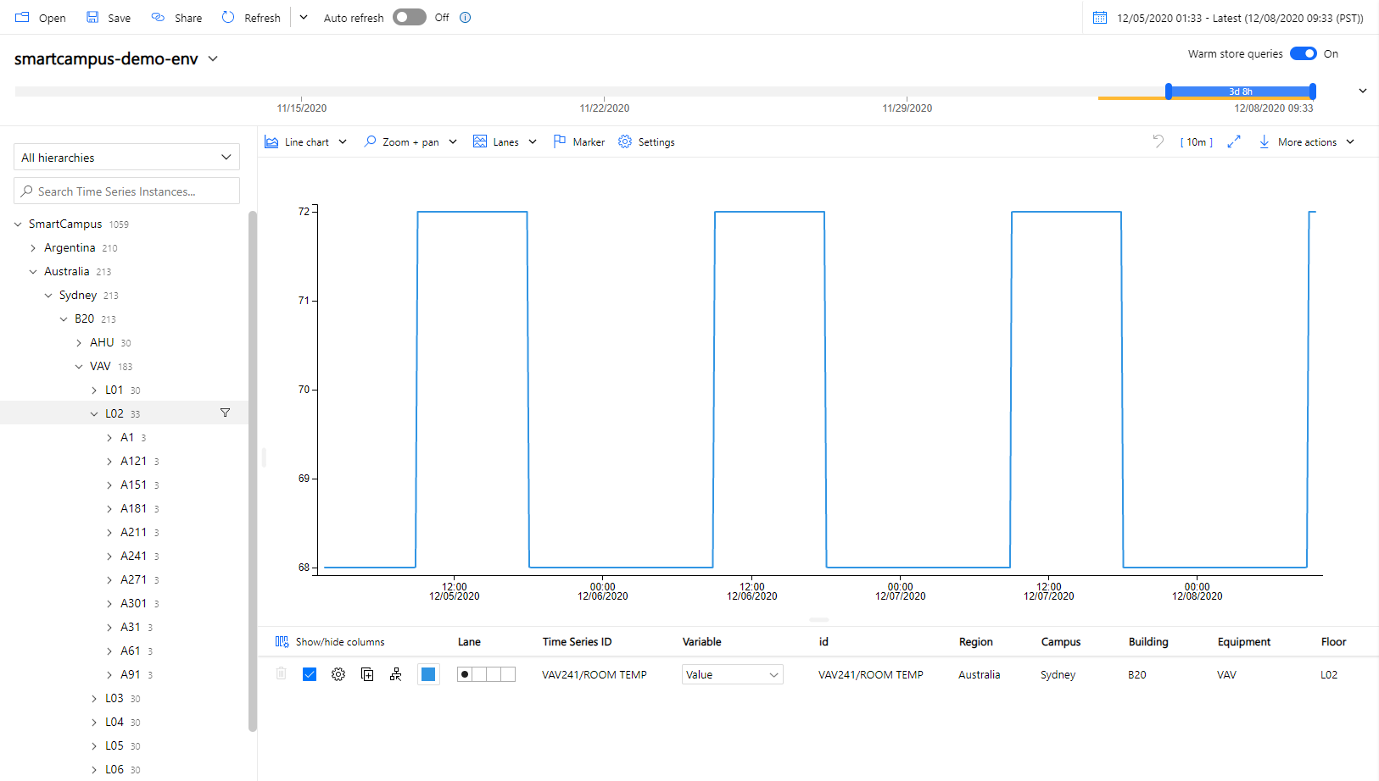

Slide 21
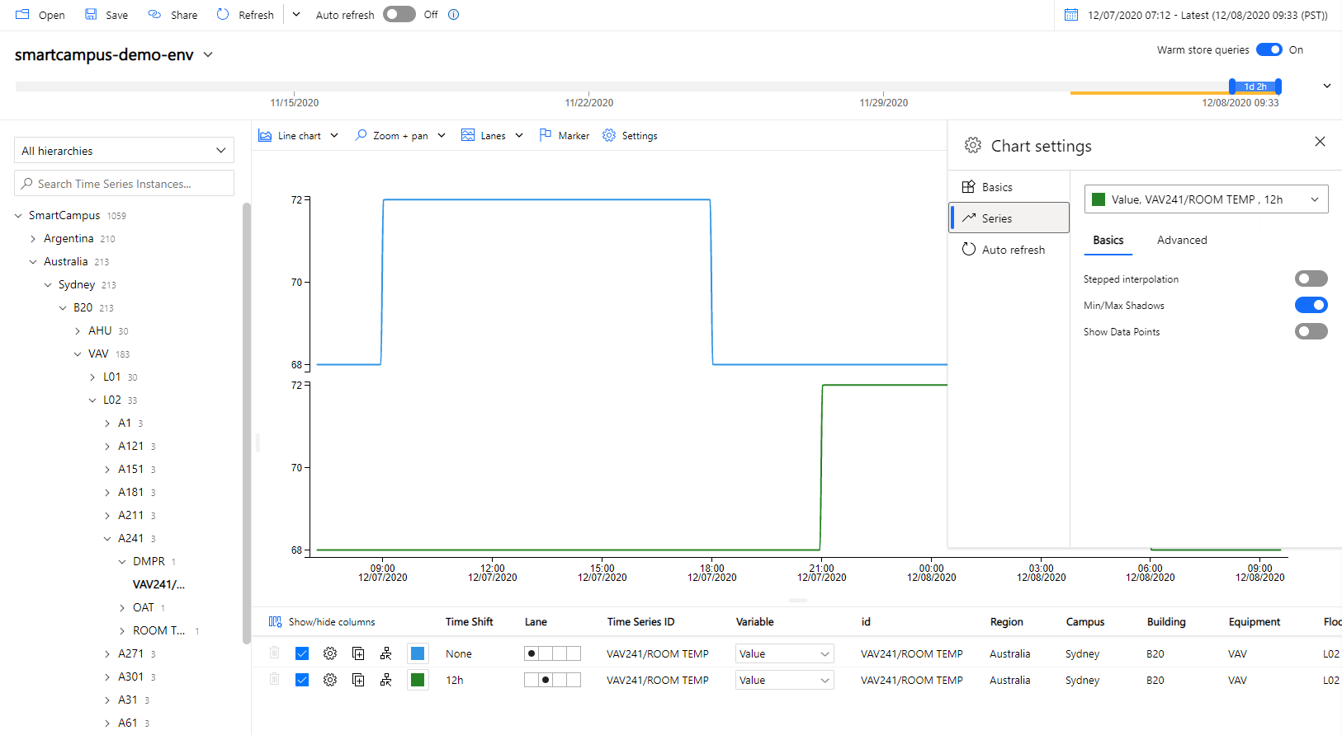

Slide 22
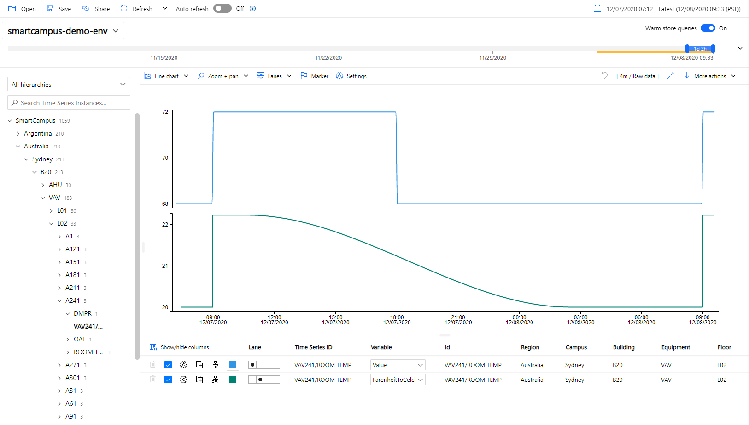

Slide 23
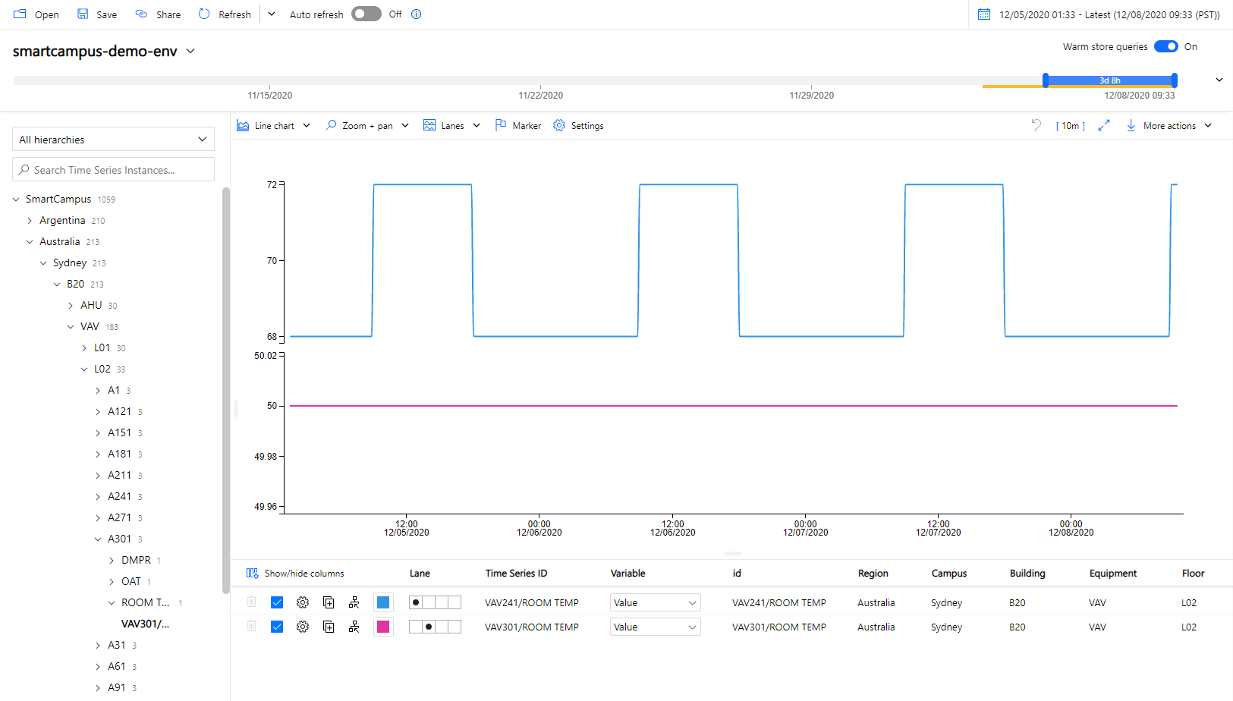

Slide 24
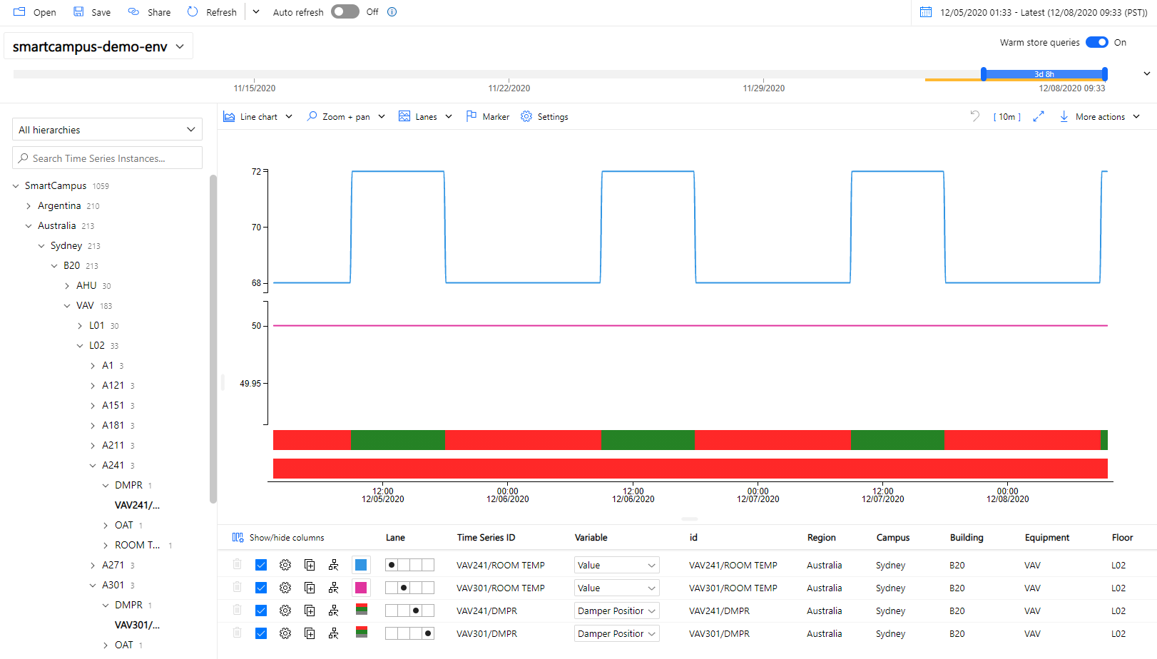

Slide 25
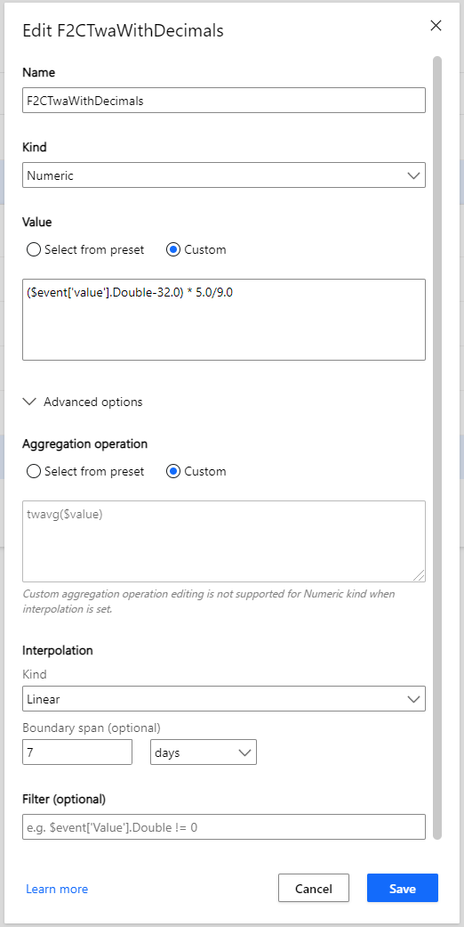
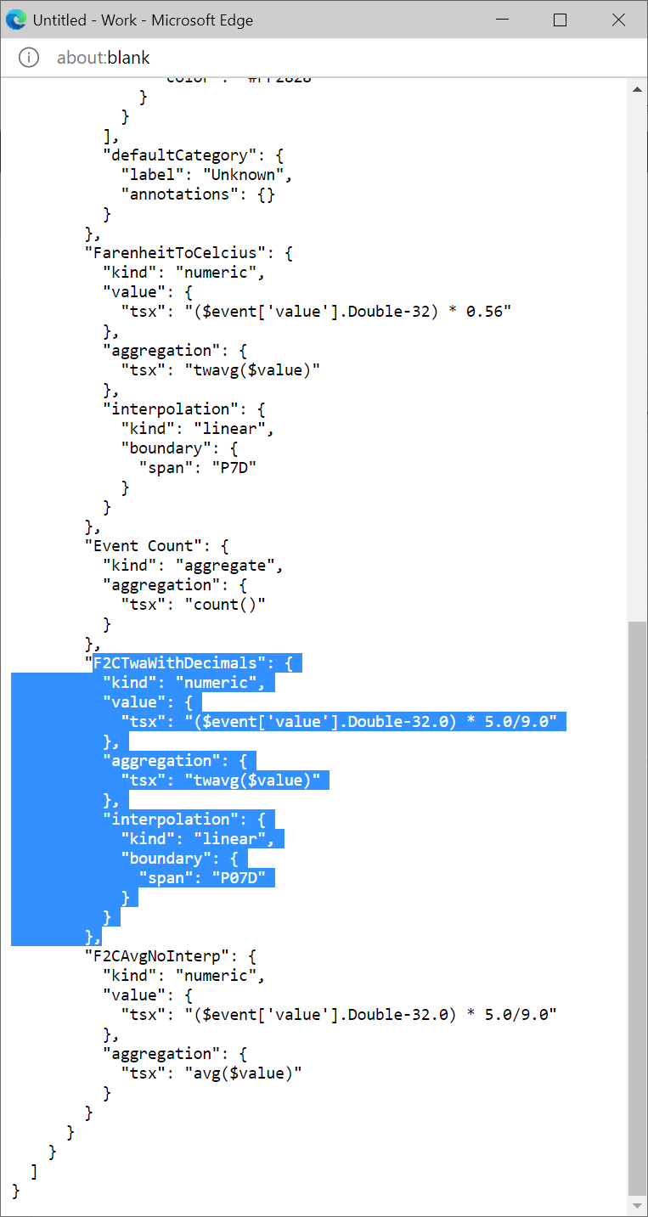
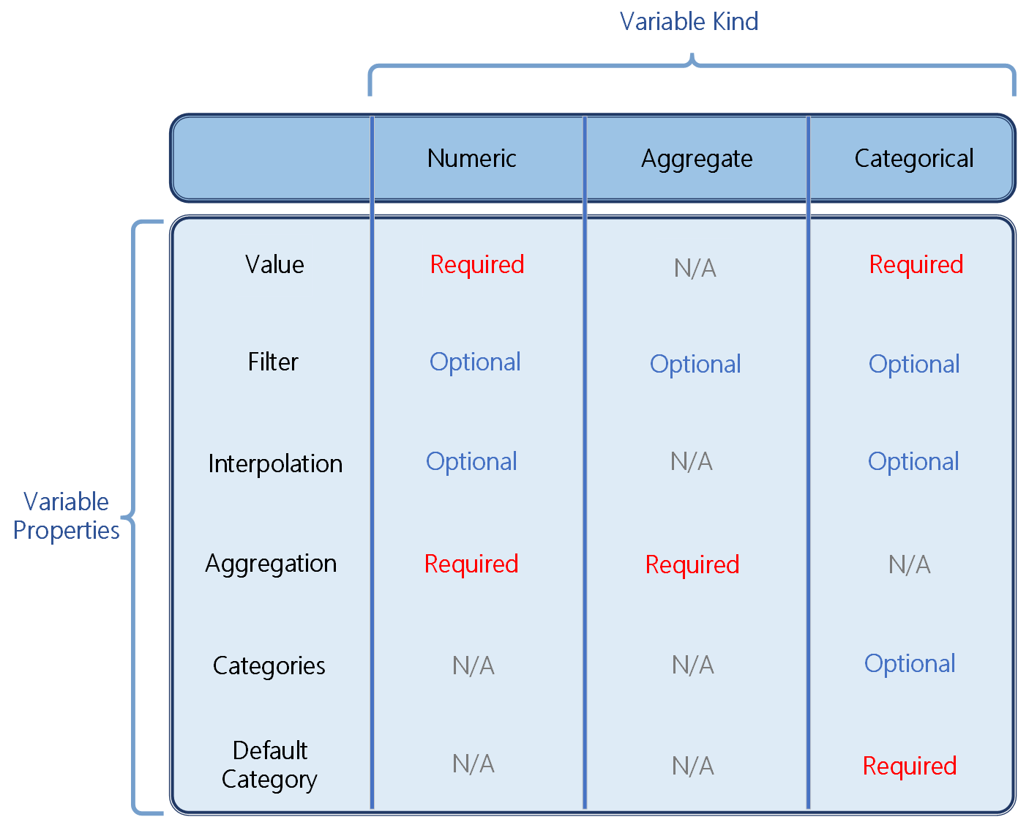

Slide 26
Appendix

